Slide 1
Midsem Presentation

Slide 2
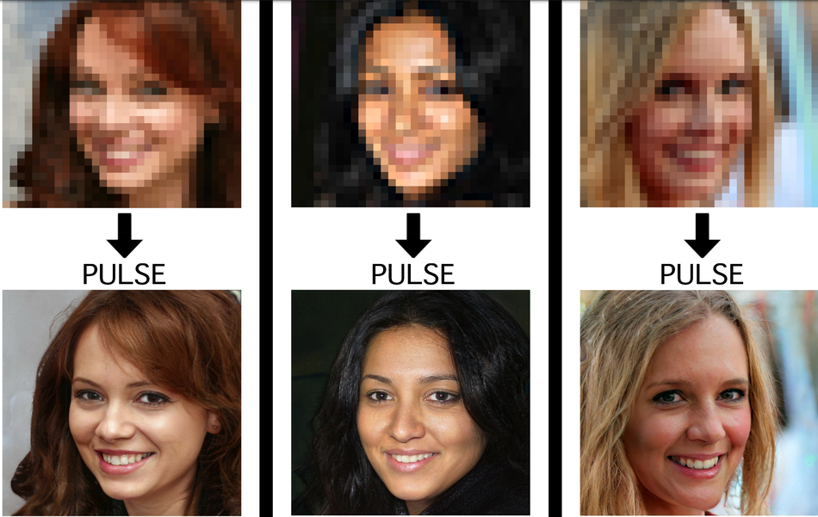
Image Super Resolution Task
Input : Low Resolution Image
Output: High Resolution Image

Slide 3
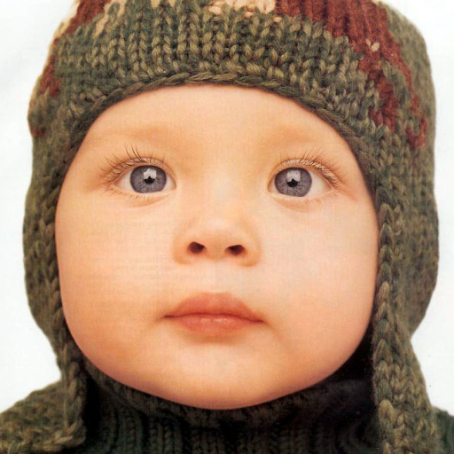
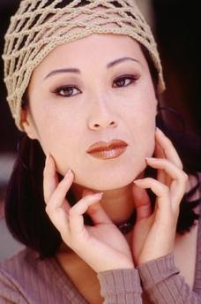
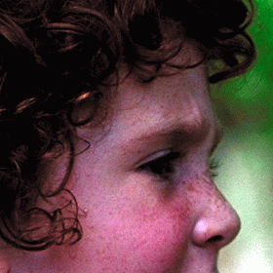
Datasets
Models are generally trained on DIV2k dataset consisting of 1000 2K resolution high quality images, generally split as 800(training) + 100(validation) + 100(testing)
And compared by testing on Set5, Set14, BSD100, Urban100 datasets.

Slide 4
Models reviewed
 | EDSR | RCAN | SRGAN | ESRGAN
Model | Used ResNets without BN to get SR image of same distribution as input. | Used channel attention to learn inter-channel feature dependencies | GAN based approach with Standard Discriminator | Uses RRDB as basic units and relativistic discriminator
Batch Normalization | No | No | Yes | No
Loss Function | L1 Loss function | L1 Loss function | Perceptual Loss for generator, Min Max Loss for discriminator | Perceptual Loss (before activation layers)
Author’s results on Set5 dataset | PSNR: 32.46 SSIM: 0.8968 | PSNR: 32.73 SSIM: 0.9013 | PSNR: 29.40 SSIM: 0.84 | PSNR: 32.73 SSIM: 0.9011

Slide 5
Architecture Hyperparameters
Hyper Param | EDSR | RCAN | SRGAN | ESRGAN
Training Dataset | DIV2K | DIV2K | ImageNet | DIV2K
Data Augmentation | Flip & rotation (x8) [done in EDSR+] | Flip & rotation (x8) [done in RCAN+] | - | Flip & rotation
Mini batch size | 16 | 16 | 16 | 16
Depth | 32 ResBlocks | 10 RGs (20 RCABs in each) | 16 ResBlocks | 23
Upscaling Factor | 2x/3x/4x/8x | 2x/3x/4x/8x | 4x | 4x

Slide 6






Qualitative Results
LR Input Image
EDSR
RCAN
SRGAN
ESRGAN
HR Ground Truth

Slide 7
Quantitative Metrics
Full Reference Metrics
Full-reference algorithms compare the input image against a pristine reference image with no distortion.
PSNR, SSIM, IFC, VIF
No reference Metrics
No-reference algorithms use statistical features of the input image to evaluate the image quality.
NIQE, Perceptual Index
Notes:
https://in.mathworks.com/help/images/image-quality-metrics.html#:~:text=over%20the%20image.-,No%2DReference%20Quality%20Metrics,to%20evaluate%20the%20image%20quality.&text=A%20BRISQUE%20model%20is%20trained,the%20same%20type%20of%20distortion.

Slide 8
Conclusions
While SRGAN argues that batch normalization leads to faster convergence, ESDR argues that BN leads to inflexibility in the output range with more parameters to learn and ESRGAN avoids BN due to artifacts in the output images. Since, the use of BN is debatable, we would train two experimental models and compare with/without BN.
From all the models, we have concluded that using residual connections have outperformed the benchmarks. So it would be a good idea to keep residual/dense nets in the final architecture along with short and long skip connections. Also, it has been suggested that deeper networks perform better than wider ones (for Super Resolution), so residual nets would help train better.
The experimental models will be trained on DIV2K dataset and tested on Set5, Set14, Urban100 and BSD100 datasets for comparing with the benchmark models.
We will use a modified loss function which is a linear combination of L₁ and L_{perceptual} in order to take into optimise both PSNR & perceptual quality of the SR image.

Slide 9
Future Plans
Approach 1:
Even though RCAN results in high PSNR values and capturing complex features of an image, it fails to deliver good perceptual loss. We intend to experiment and modify the loss functions in RCAN to deliver better results.
Approach 2:
Improving the ESRGAN to take Channel Attention(as in RCAN) into account as well, as this might lead to better overall learning and better PSNR values in the architecture.

